Slide 1

Genetic Algorithm: A First Introduction
Professor Bo Liu
James Watt School of Engineering

Slide 2
Overview of genetic algorithms
GA was developed in 1970s and is being widely applied.
There are many different versions nowadays, called genetic algorithms (GAs).
GAs are for solving optimization problems.
  Easy to comprehend and apply,
  Capable of solving some complex optimization problems,
  Popular with the increase of computing power.

Slide 3
The intelligence to be borrowed
Computational intelligence (such as Neural Networks and Evolutionary Computation) builds problem solvers by copying ideas from God/nature
Brains → artificial neural networks
Evolution → evolutionary computation

Slide 4
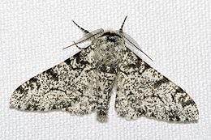
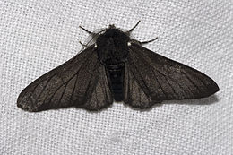
Manchester Moth Story
Before industrial revolution
After industrial revolution

Slide 5
Essential elements that can be extracted from “evolution”
Population
  A number of individuals form a population.
Selection: Survival of the fittest
  The better an individual is, the more possible it will become a parent for the next generation.
Crossover
  The chromosome of a child is composed by chromosomes from its parents.
Mutation
  In some occasions, some part of the chromosome can be randomly changed.

Slide 6
Use “evolution” to solve an optimization problem
A solution in the search space → an individual in natural evolution
We call it solution or individual or point
Evolution → “Create” better solutions.
Selection
A population of solutions
Mating pool (parent set)
Replacement
Crossover
Mutation
New solutions

Slide 7




Thanks!
#UofGWorldChangers
@UofGlasgow

